Slide 1
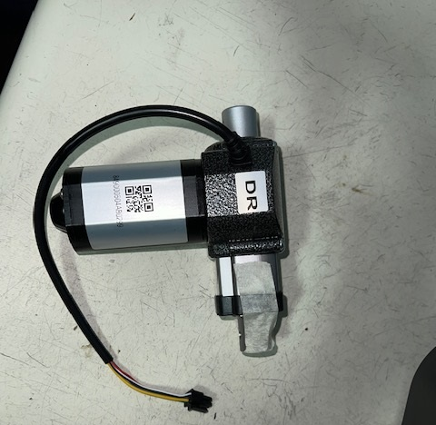
Cobi 18
Squeegee Actuator
Replacement
Contact ICE Cobotics with any questions. 833-ICE-ROBO

Slide 2
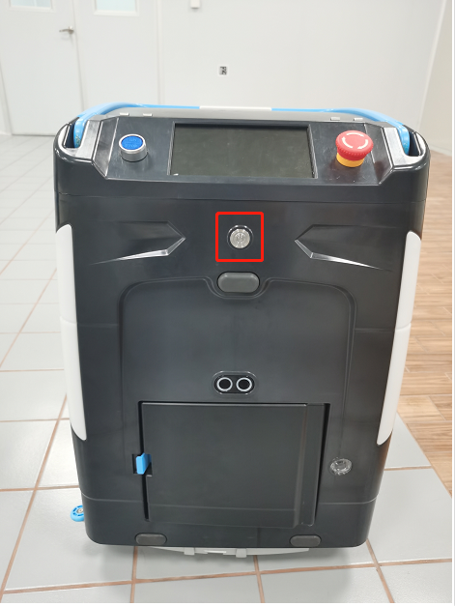
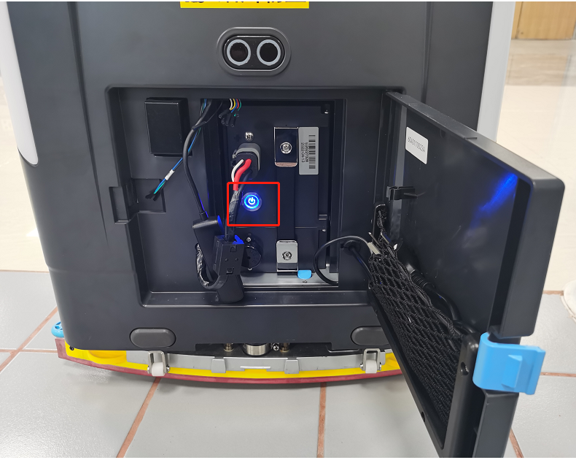
Power Off Machine & Battery
1
Power off machine (photo 1)
Power off battery (photo 2)
Unplug battery cable
2

Slide 3
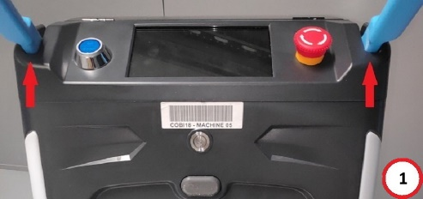
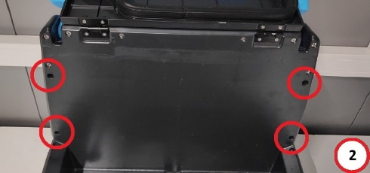
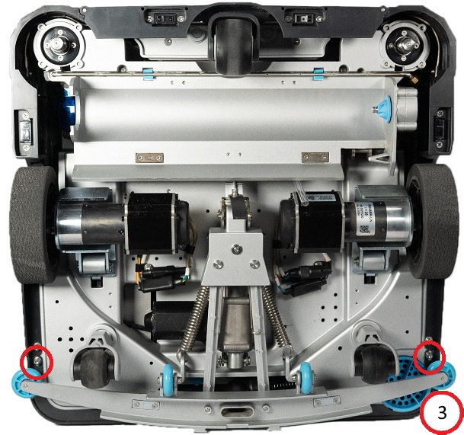
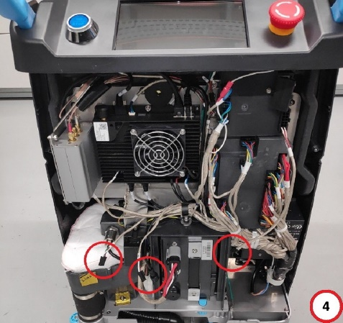
Rear Cover Removal
Remove the back cover by unscrewing 2 – Phillips head (or 2.5 allen) screws under the handle. (1)
Remove 4 – Phillips head (or 2.5 allen) screws inside the Water tank compartment (2)
Remove 2 – 3mm hex head bolts at the bottom of the machine (3)
Disconnect the power cables from the back cover, mark them if needed (4)

Slide 4
Internal Electrical Component Locations (fyi)
1
2
3
4
Speaker
VCU (Vehicle Control Unit)
Modem
Main Board
MCU (Motor Control Unit)
Battery
Battery Charger
5
7
6

Slide 5
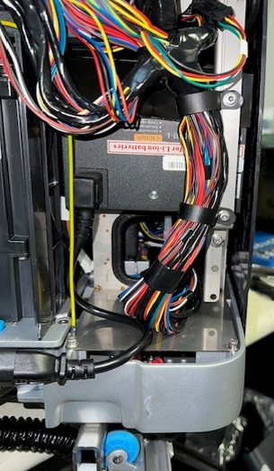
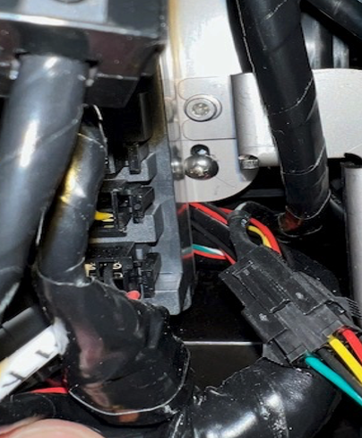
Remove Battery Charger
- Removal of battery charger allows access to squeegee actuator wiring.
Remove battery charger mount and wire harness clips. (5 - H3 Allen head)
Pull charger and mount away from machine to access actuator wire.
*Watch for sharp edges on charger mount*

Slide 6
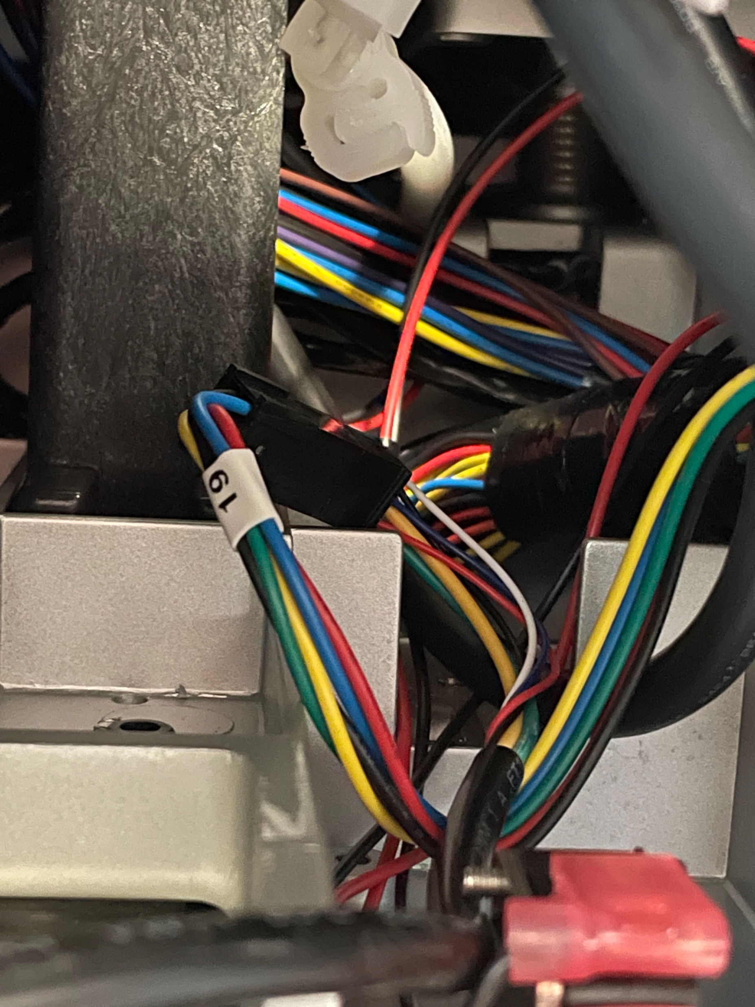
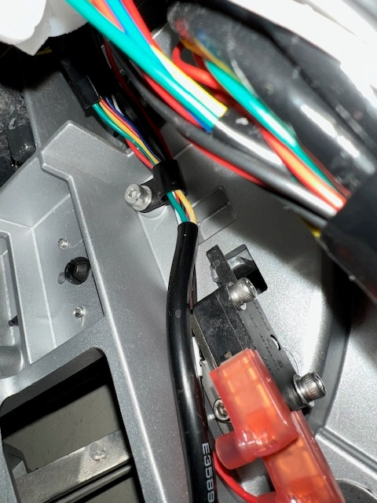
Disconnect Actuator Wiring
- Electrical connection is located behind where the charger was mounted.
Disconnect actuator plug #19.
Remove wire clip. (H3 Allen head)

Slide 7
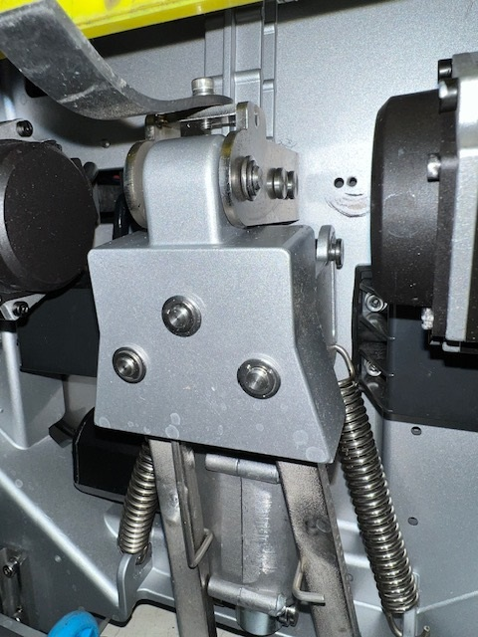
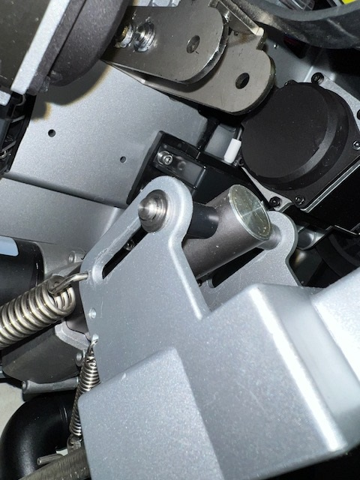
Actuator Removal
Note: The E-clips are small and can easily fall away upon removal. Keep an eye on them!
On the bottom of machine in the center (by the grounding strap) remove the retaining clip and pin.
Remove the retaining clip and pin.
Remove the retaining clip and pin at the bottom of the actuator.
Remove original actuator.
Install new actuator by reassembling in reverse order. Please remember to reconnect all electrical connections.

Slide 8
Reboot & Test Machine - Test new actuator performance
1
Plug power cable back into battery (photo 2)
Power on battery (photo 2)
WAIT 2 MINUTES (this allows the modem time to properly reset)
Power on machine (photo 1)
When machine boots up, enter password 657870
Run a route and ensure squeegee automatically goes up and down.
Contact ICE Cobotics with any questions. 833-ICE-ROBO
2

