Slide 1
Trouble Shooting Water Pick Up- Squeegee
Squeegee
Clear any loose debris from squeegee blade. Rinse under hose.
Clean any blockages from vacuum opening.
Check the rear squeegee blade for a good edge end to end. Once this becomes too worn the squeegee assembly will need to be replaced.
Recommended to do this daily

Slide 2
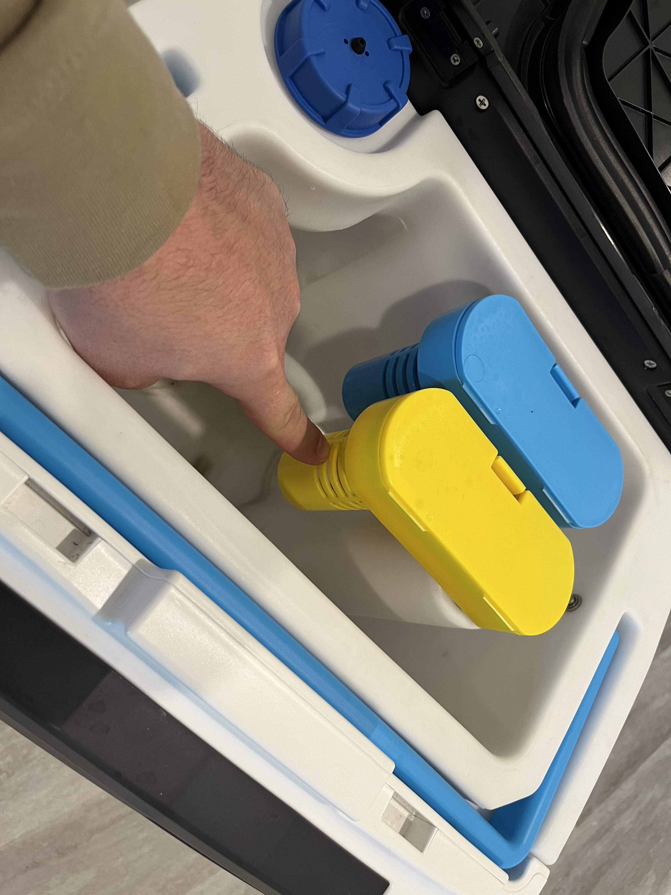
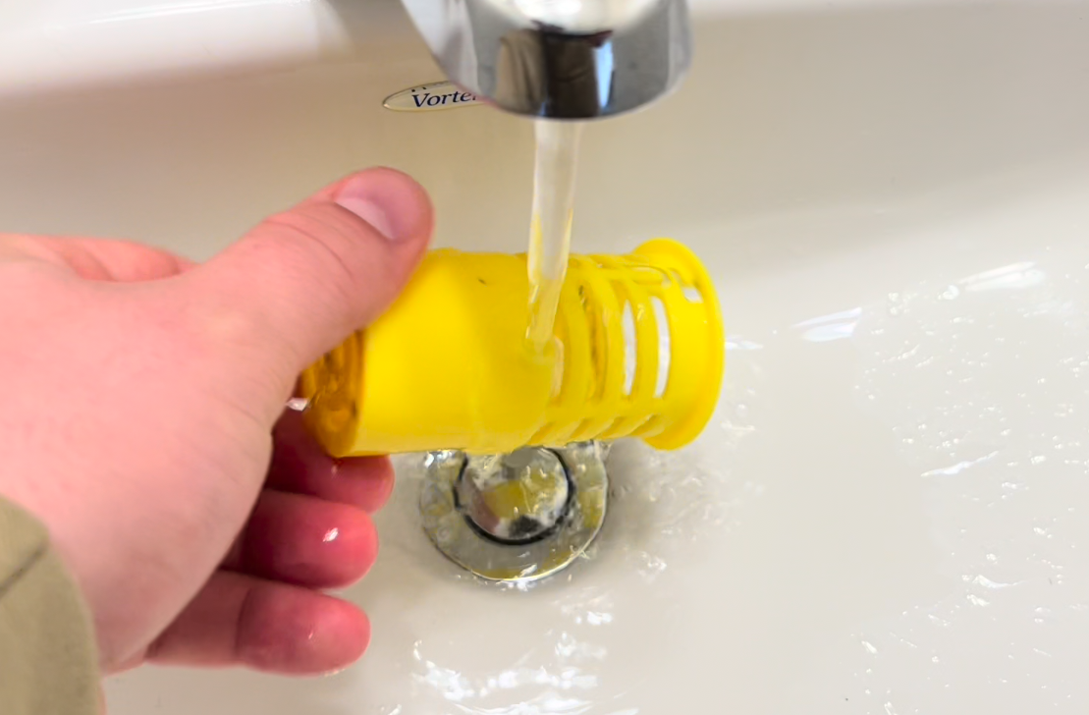
Trouble Shooting Water Pick Up- Recovery tank filter
Recovery Tank Debris Basket
Remove yellow debris basket inside recovery tank. Debris buildup will reduce suction
Remove debris basket by gently twisting off from underneath.
Rinse out debris under sink or with hose.
Recommended to do this daily

Slide 3
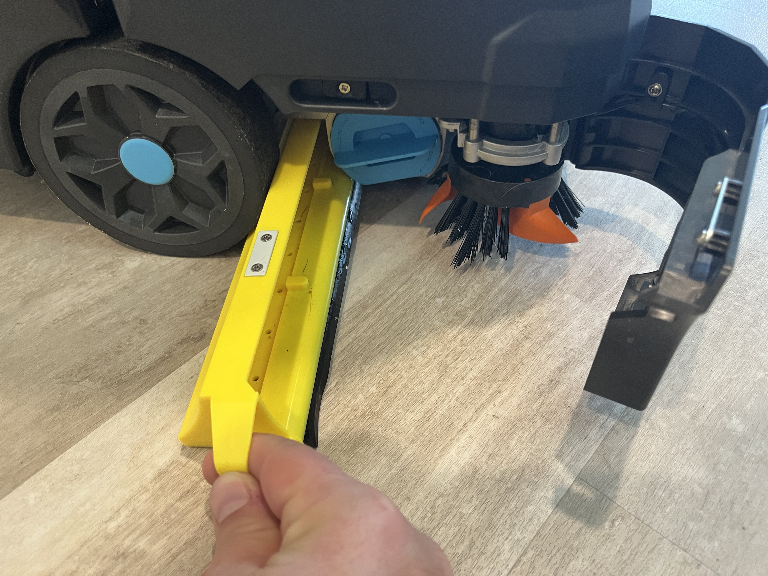
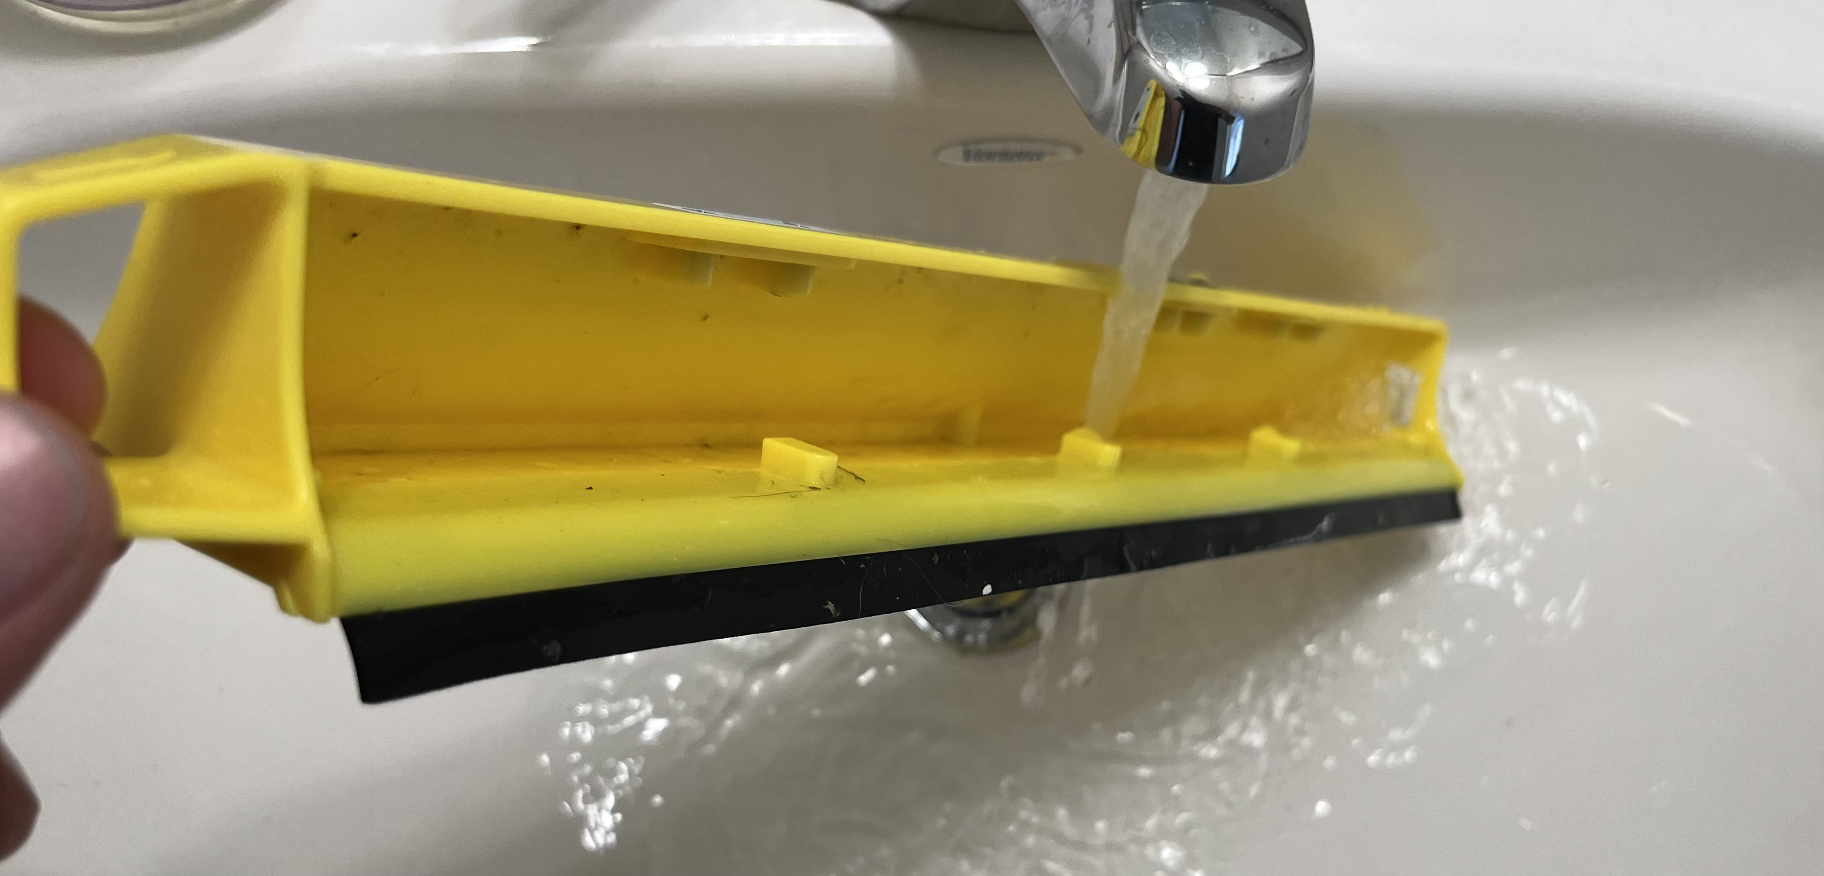
Trouble Shooting Water Pick Up- Debris Tray
Debris Tray
Remove yellow debris tray behind brushes.
Clear of any large debris and soil.
Rinse out debris under sink or with hose.
Recommended to do this daily

Slide 4
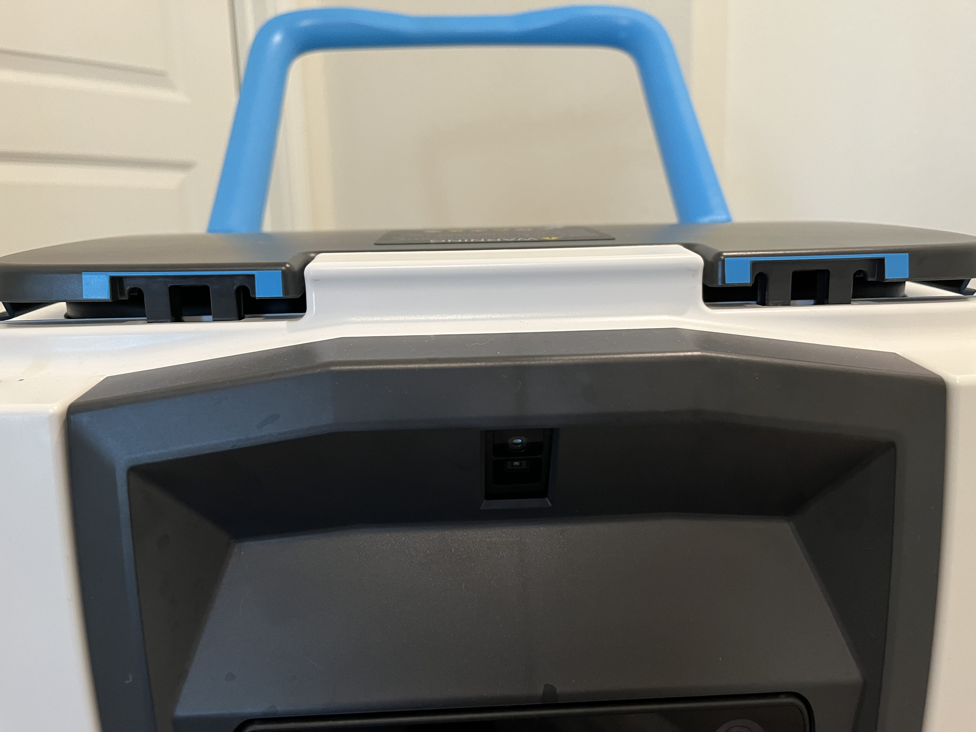
Trouble Shooting Water Pick Up- Recovery Tank Lid
Make sure the black lid is completely closed. The lid snaps into place at two places shown here. If lid is not fully closed, you will lose suction.

